Slide 1

ProtoControl
Kelly Mae Allen, Abisha Fenn, Nida Kosedagi, Parker Sexton, William Wood

Slide 2
Plans for Design Day Demo and Setup
3D Printer
MCU:
Raspberry Pi
Technical Tasks Remaining:
build enclosure
Build claw
Polish
II. Team 33
MCU:
Pic32 mz wfi3e01
Technical Tasks Remaining:
Integrate UART decoding
make profiles for test
III. 306 Car
MCU: MSP 430
Technical Tasks Remaining:
Replace wheels with demo
LCD display
IV. Arduino
MCU: Arduino
Technical Tasks Remaining:
Alpha Demo
Polish up components to demo
Table: Poster + Screen + Demo 1,3,4 + User Manual + Technical Specifications

Slide 3
Team 33 Collaboration
System Requirements
MCU: Pic32 mz wfi3e01
Multiple profiles (Home screen, test 1 screen)
Home Screen
Button to start the test
Pinch test
Slider for cat weight - 0 - 20 - display slider value on slider
Touchscreen: buttons, sliders + 5 buttons
Communication: UART with Power Supply

Slide 4
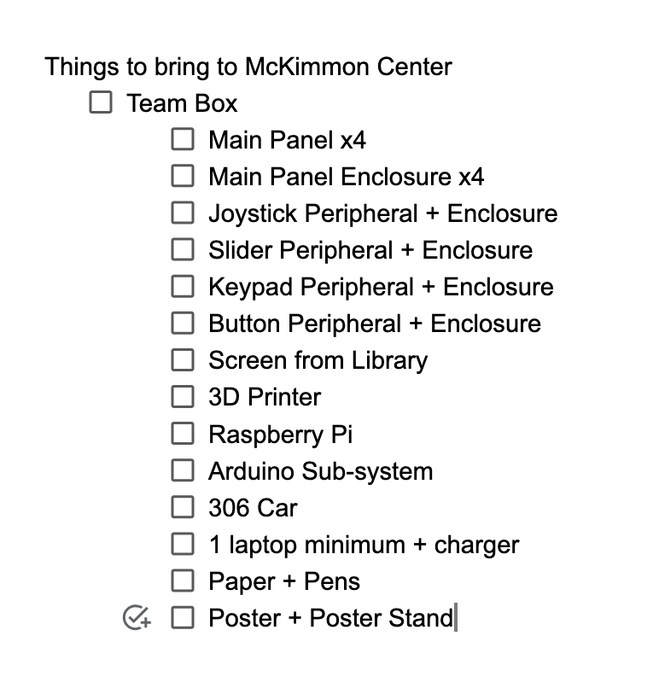
Plans for Design Day Team Presentation
Poster Ideas
Concise Problem Statement…customer view, Project Requirements Summary
Major design challenges
User Flow Diagram + Use cases
Website Backend
Functional Block Diagram + UART + I2C breakdown
Photos of Main Panel + Peripherals + Enclosure (custom pcb design)
Code Snippets
Power Usage Over Time

Slide 5
Plans for Closure Documentation
In lieu of Sponsor Meeting we will wrap up as a team
User Documentation
Example sketches
Technical Specs.
Assembly Instructions
UML diagrams, table, schematics, drawings, design justifications
Closing Report for SDII

Slide 6
Task Breakdown and Timeline
High Priority
Enclosure Done (4/10)
Finish the 3D printer Demo (4/10)
Setup Team 33 (4/12)
Poster (4/12)
Assembly Day (4/12-4/15)
Test Wifi at McKimmon
User Manual (4/14)
Low Priority
Technical Spec. Sheet (4/17)
Polish Up the Arduino User System (4/17)
Polish up the 306 demo (4/17)
Enclosure for 3D Printer
Final Document Package
Notes:
**Risk Mitigation (maybe make a list of high priority and optional)

Slide 7

Team Charter

